Slide 1

Foreign Direct Investment Analytics Project
By Sanket Khot

Slide 2
Project Details
Project Title | Foreign Direct Investment Analytics
Technology | Data Science
Domain | Finance
Programming Language and Library Used | Python and Pandas, Matplotlib, Seaborn
Tools Used | Jupyter Notebook(Google Colab), MS-Excel

Slide 3


Project Report
ANALYSIS
SPECIFICATION
IMPLEMENT
PROJECT
DESIGN
TESTING
DEVELOP

Slide 4
Problem Statement
Investment is a game of understanding historic data of investment objects under different events but it is still a game of chances to minimize the risk we apply analytics to find the equilibrium investment.
To understand the Foreign direct investment in India for the last 17 years from 2000-01 to 2016-17. This dataset contains sector and financial year-wise data of FDI in India.
Sector-wise investment analysis.
Year-wise investment analysis.

Slide 5
Objective
The goal of this project is to understand the Foreign Direct Investment in India for the last 17 years from 2000-01 to 2016-17.

Slide 6
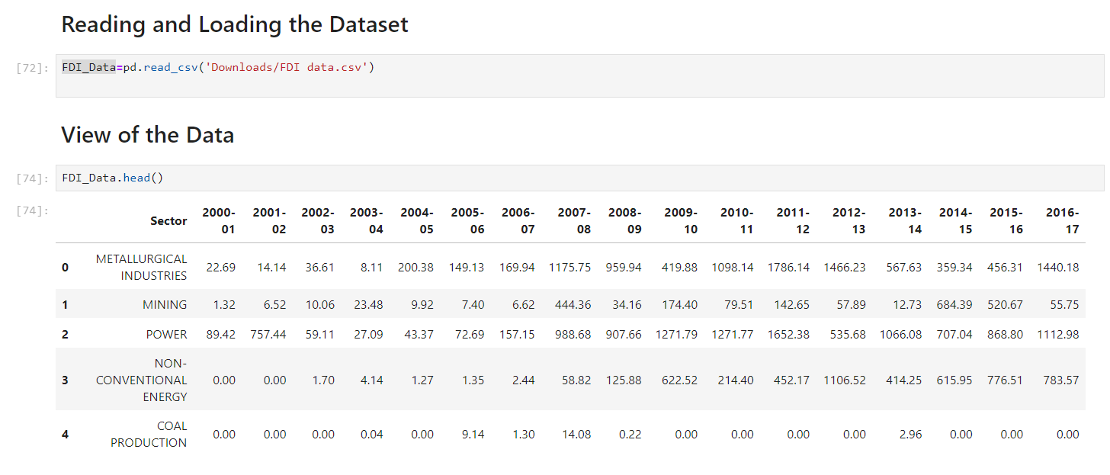
Data Source

Slide 7
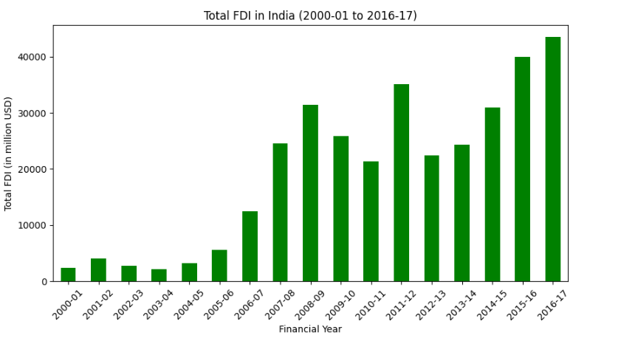
Year-Wise Total Investment in India
The highest total investment was done in the year of 2016-17.

Slide 8
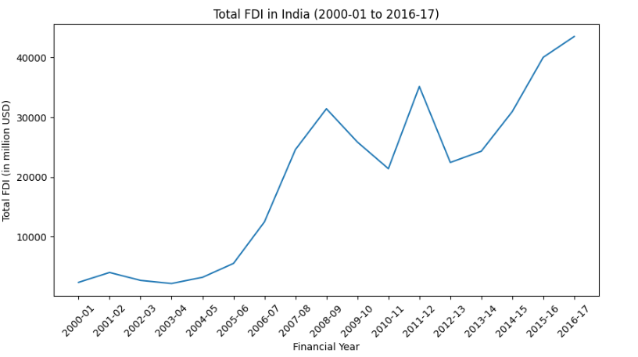
Trend of FDI over the years
Total investment is continuously increasing in every year.

Slide 9
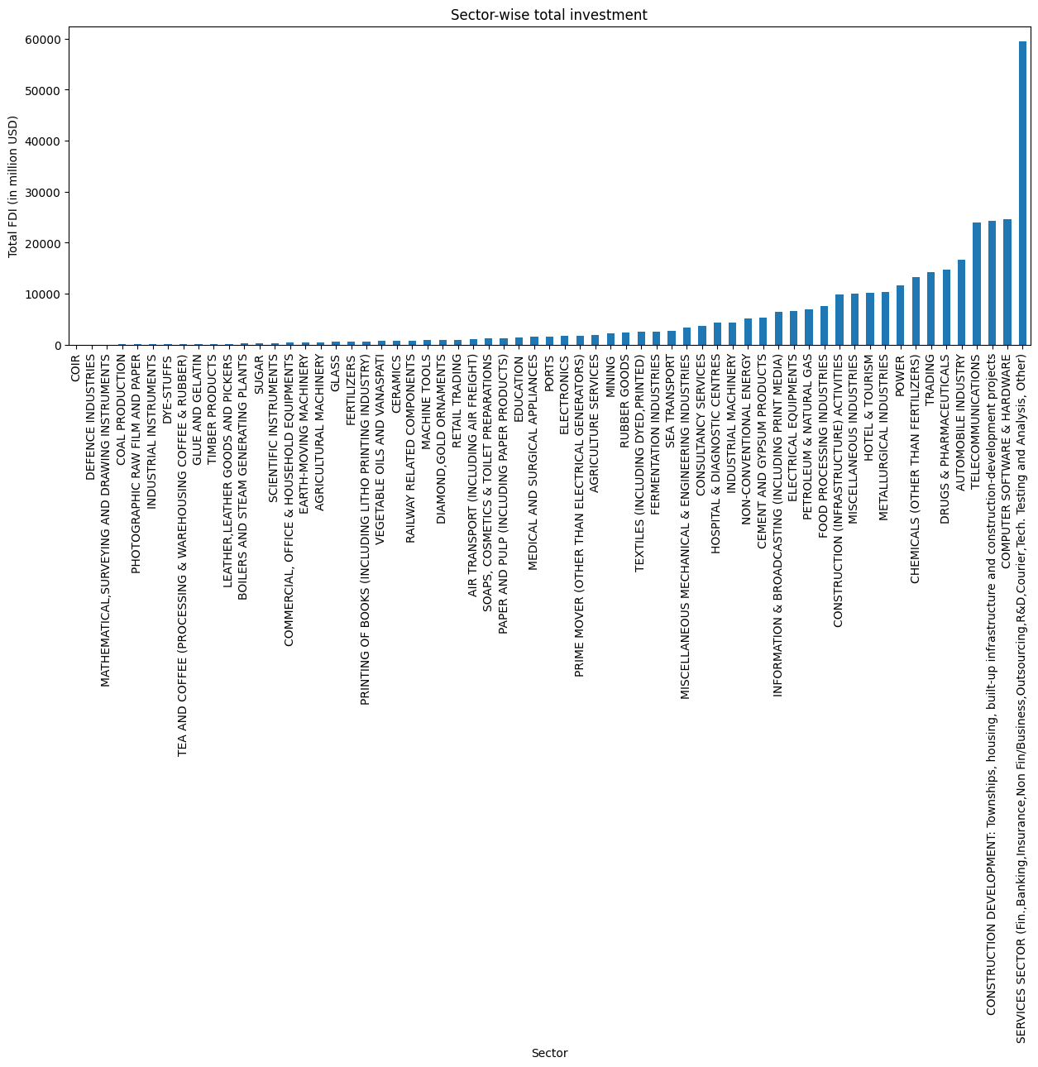
Sector-wise Total Investment

Slide 10
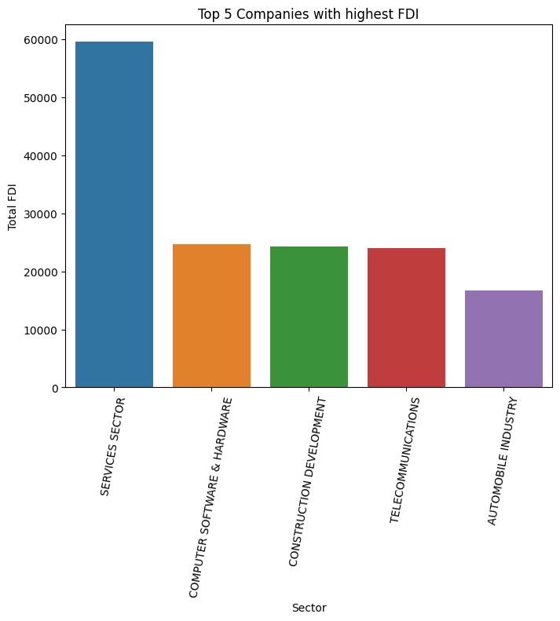
Top-5 Sector/Companies with highest FDI

Slide 11
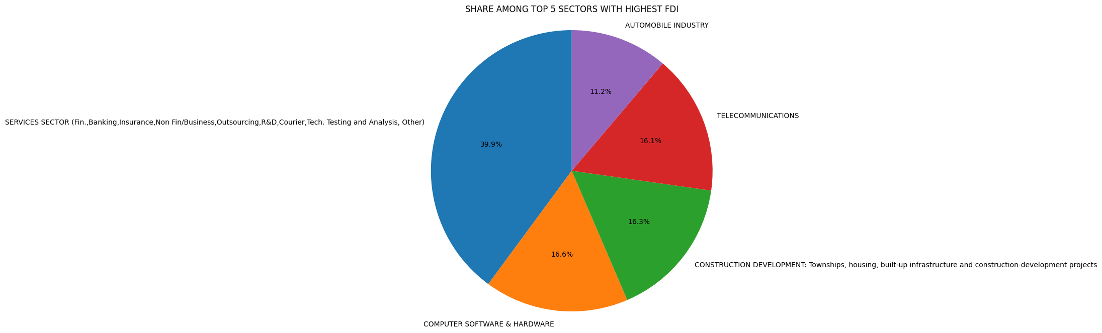
Percentage Share Among Top 5 Sectors with Highest FDI

Slide 12
Observation
The Sectors investment of FDI over the period of 2000 to 2017, we can find the largest recipient of such investment is service sector (Financial and non-financial services). The share of this sector in FDI flows is 39.9% of the inflow total foreign direct investment. And others like Computer software and hardware has 16.6%. Construction development has occupied 16.3%, Telecommunications 16.1 and Automobile industry 11.2%.
Their is very low investment towards sectors like Coir, Defence Industries, Mathematical, surveying and drawing Instruments, Coal Production. There are around 10 to 15 sectors, investment is very less and some of this like zero.
Based on Year-wise investment, we can say that the highest total investment was done in the year of 2016-17. And in the year of 2000-01,2003-04 was lowest investment. And total investment is continuously increasing in every year.

Slide 13
Conclusion
Foreign Direct Investment plays a significant role in the long-term progress of a country not only as a source of capital but also for increasing competitiveness of the domestic economy through strengthening infrastructure, transfer of technology, generating new employment opportunities and raising productivity. India emerges as the 5th largest recipient of FDI across the globe and 2nd largest among all other developing countries (World Investment Report 2010). Foreign Direct Investment always helps to create employment in the nation and also provides support to the small scale industries and helps countries to put an impression on the worldwide level through globalization and liberalization.

Slide 14

Thank You

